Slide 2
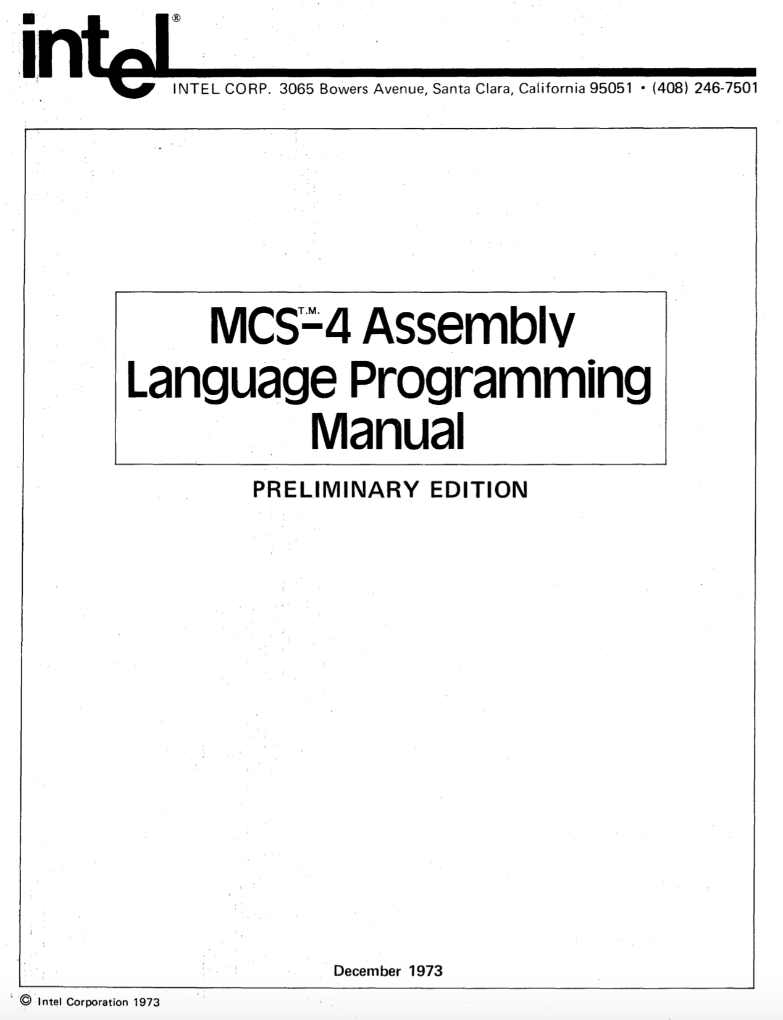

https://github.com/alshapton/Pyntel4004
Assembly Language
Programming Manual
July 2021
Andrew Shapton 2021

Slide 3
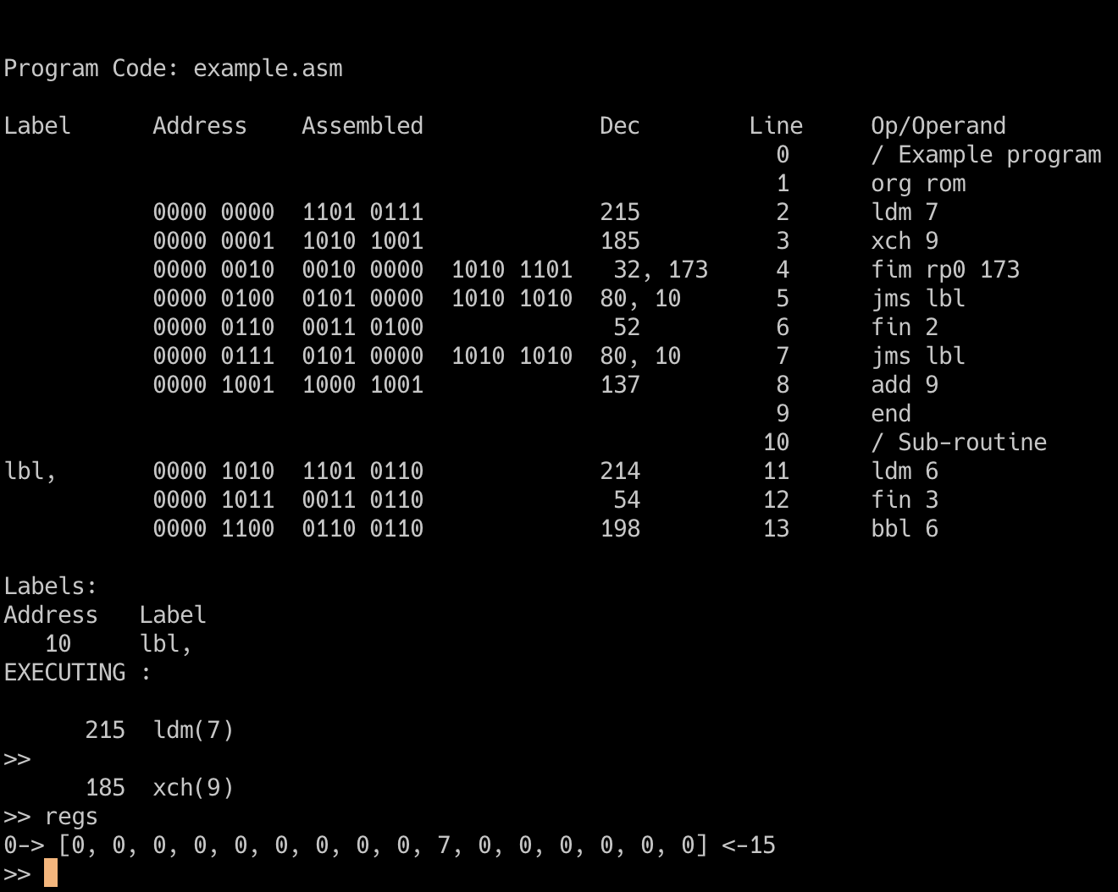
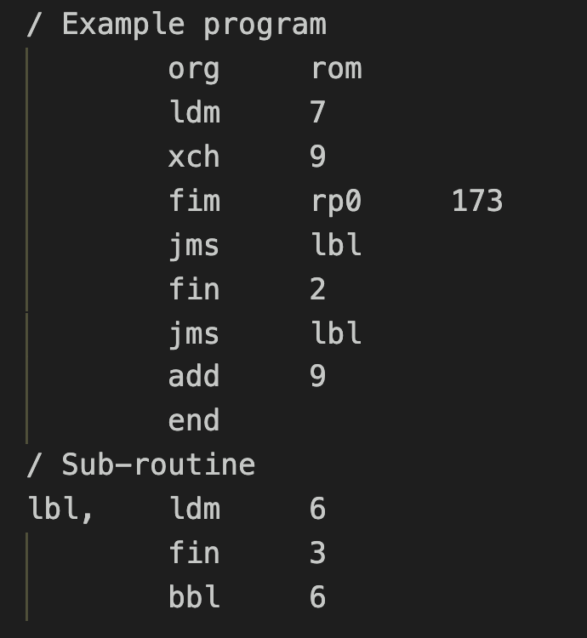

Slide 4
0 0 0 1 C₁ C₂ C₃ C₄
A₂ A₂ A₂ A₂ A₁ A₁ A₁ A₁
If C₁C₂C₃C₄ is true:
A₂A₂A₂A₂ PM A₁A₁A₁A₁ PL
PH unchanged if C₁C₂C₃C₄ is false: (PH) PH
(PM) PM
(PL + 2) PL
C₁ C₂ C₃ C₄
If the indicated Condition Bit is = 1:
Jump if the 4004 Test Signal is = 0
Jump if the Carry Bit is = 1
Jump if the Accumulator = 0
Invert ALL the other conditions
JUMP = C₁ * ((ACC = 0) * C₂ + (carry = 1) * C₃ + TEST * C₄ +
C₁ * (((ACC <> 0) + C₂ ) + ((carry = 0) + C₃ ) * (TEST + C₄ )
JCN

Slide 5
0 0 1 0 R_{p} R_{p} R_{p} 0
D₁ D₂D₃ D₄ D₅ D₆ D₇D₈
0 0 1 0 R_{p} R_{p} R_{p} 0
000 for register pair 0 or 0P
001 for register pair 2 or 1P
010 for register pair 4 or 2P
011 for register pair 6 or 3P
100 for register pair 8 or 4P
101 for register pair 10 or 5P
110 for register pair 12 or 6P
111 for register pair 14 or 7P
8-bit data quantity
000 for register pair 0 or 0P
001 for register pair 2 or 1P
010 for register pair 4 or 2P
011 for register pair 6 or 3P
100 for register pair 8 or 4P
101 for register pair 10 or 5P
110 for register pair 12 or 6P
111 for register pair 14 or 7P
D₁D₂D₃D₄
R_{p} R_{p} R_{p} R_{p}
(RP_{p})
DB(x2)
(RRRO) --> DB (X2) (RRR1) --> DB (X3)
D₅D₆D₇D₈
R_{p+1} R_{p+1} R_{p+1} R_{p+1}
(RP_{p+1})
DB(x3)
FIM
SRC 1

Slide 6
When referring to a DATA Ram character
When referring to a DATA RAM status character
1 of 16 characters within the register
Not relevant
1 of 4 registers within the DATA RAM chip
1 of 4 registers within the DATA RAM chip
1 of 4 DATA RAM chips within the DATA RAM bank previously selected with a DCL instruction
1 of 4 DATA RAM chips within the DATA RAM bank previously selected with a DCL instruction
SRC 2

Slide 7
When referring to RAM output port
When referring to a ROM input/output port
Not relevant
Not relevant
The port associated with 1 of 4 DATA RAM chips within the DATA RAM bank previously selected by a DCL instruction.
The port associated with 1 of 16 ROMs.
SRC 3

Slide 8
0 0 1 1 R_{p} R_{p} R_{p} 1
0 1 0 0 A₃ A₃ A₃ A₃
A₂ A₂ A₂ A₂ A₁ A₁ A₁ A₁
000 for register pair 0 or 0P
001 for register pair 2 or 1P
010 for register pair 4 or 2P
011 for register pair 6 or 3P
100 for register pair 8 or 4P
101 for register pair 10 or 5P
110 for register pair 12 or 6P
111 for register pair 14 or 7P
12-bit address
A₃ A₃ A₃ A₃
P_{H}
A₂ A₂ A₂ A₂
P_{M}
A₁ A₁ A₁ A₁
P_{L}
P_{H}
P_{H}
unchanged
R_{p} R_{p} R_{p} R_{p}
P_{M}
R_{p+1} R_{p+1} R_{p+1} R_{p+1}
P_{L}
JUN
JIN

Slide 9
0 0 1 1 R_{p} R_{p} R_{p} 0
0 1 0 1 A₃ A₃ A₃ A₃
A₂ A₂ A₂ A₂ A₁ A₁ A₁ A₁
000 for register pair 0 or 0P
001 for register pair 2 or 1P
010 for register pair 4 or 2P
011 for register pair 6 or 3P
100 for register pair 8 or 4P
101 for register pair 10 or 5P
110 for register pair 12 or 6P
111 for register pair 14 or 7P
12-bit address
A₃ A₃ A₃ A₃
P_{H}
A₂ A₂ A₂ A₂
P_{M}
A₁ A₁ A₁ A₁
P_{L}
( (P_{H}) . (R₀) . (R₁) ) RP_{p}
OR
( (P_{H+1}) . (R₀) . (R₁) ) RP_{p}
JMS
FIN

Slide 10
0 1 1 1 R R R R
A₂ A₂ A₂ A₂ A₁ A₁ A₁ A₁
0 1 1 0 R R R R
0000 for Register 0
0001 for Register 1
0010 for Register 2
0011 for Register 3
0100 for Register 4
0101 for Register 5
0110 for Register 6
0111 for Register 7
1000 for Register 8
1001 for Register 9
1010 for Register 10
1011 for Register 11
1100 for Register 12
1101 for Register 13
1110 for Register 14
1111 for Register 15
8-bit address
0000 for Register 0
0001 for Register 1
0010 for Register 2
0011 for Register 3
0100 for Register 4
0101 for Register 5
0110 for Register 6
0111 for Register 7
1000 for Register 8
1001 for Register 9
1010 for Register 10
1011 for Register 11
1100 for Register 12
1101 for Register 13
1110 for Register 14
1111 for Register 15
(RRRR) + 1
RRRR
If result = 0
(P_{H})
P_{H}
(P_{M})
P_{M}
(P_{L}+2)
P_{L}
If result <> 0
(P_{H})
P_{H}
(A₂ A₂ A₂ A₂)
P_{M}
(A₁ A₁ A₁ A₁)
P_{L}
ISZ
(RRRR) + 1
INC
RRRR
A₃ A₃ A₃ A₃
P_{H}
A₂ A₂ A₂ A₂
P_{M}
A₁ A₁ A₁ A₁
P_{L}
( (P_{H}) . (R₀) . (R₁) ) RP_{p}
OR
( (P_{H+1}) . (R₀) . (R₁) ) RP_{p}

Slide 11
1 0 0 0 R R R R
A₂ A₂ A₂ A₂ A₁ A₁ A₁ A₁
0000 for Register 0
0001 for Register 1
0010 for Register 2
0011 for Register 3
0100 for Register 4
0101 for Register 5
0110 for Register 6
0111 for Register 7
1000 for Register 8
1001 for Register 9
1010 for Register 10
1011 for Register 11
1100 for Register 12
1101 for Register 13
1110 for Register 14
1111 for Register 15
12-bit address
A₃ A₃ A₃ A₃
P_{H}
A₂ A₂ A₂ A₂
P_{M}
A₁ A₁ A₁ A₁
P_{L}
( (P_{H}) . (R₀) . (R₁) ) RP_{p}
OR
( (P_{H+1}) . (R₀) . (R₁) ) RP_{p}
ADD
(RRRR) + (ACC) + (CY) ACC, CY

Slide 12
Introduction date: |  | November 15, 1971
Type: |  | 4-bit microprocessor (8-bit instructions)
Frequency: |  | 500KHz - 740KHz
Technology: |  | P-channel silicon gate MOS technology
Number of transistors: |  | 2,300 (10 microns)
Addressable Memory |  | 4096x8-bit ROM and 1280x4-bit RAM
Number of Instructions |  | 45 with a 4 level stack and sixteen 4-bit (or eight 8-bit) registers
History: |  | In 1969 Busicom asked Intel to design a set of chips to be used in a new high perfomance calculator. Ted Hoff, Federico Faggin and Stan Mazor came up with a design that involved a central processing unit, 4004 (CPU) a read-only memory, 4001 (ROM) a random access memory, 4002 (RAM) and a shift register, 4003 (I/O). The CPU was eventually to be called a microprocessor. Later Intel negotiated for a return of the rights for the chips, which had gone to Busicom in the original contract.
Second source: |  | National Semiconductors was the only second source to Intel 4004.
Reset
9
8
Sync-Out
Test
10
7
Clk Phase 2
Memory
Control
Output
CM-ROM
Clk Phase 1
11
6
V_{DD}
12
5
V_{SS}
i4004
PINS
CM-RAM3
13
4
D3
9
8
10
7
CM-RAM2
14
3
D2
11
Memory
Control
Outputs
Data
Bus
I/O
6
12
5
CM-RAM1
15
2
D1
13
4
3
CM-RAM0
16
1
D0
14
15
2
16
1

Slide 13
Introduction date: |  | 1971
Type: |  | 0-bit Serial-in/Parallel-out, Serial-out Shift Register.
Memory: |  | 256 x 8-bit
Technology: |  | P-channel silicon gate MOS technology
Number of transistors:
History: |  | The 4003 was designed to be used with other MCS-4/40 devices such as the 4004 CPU.
Second Source |  | National Semiconductors was the only second source.
Q₅
9
8
Q₄
Q₆
10
7
Q₃
Parallel
Output
Parallel
Output
Q₇
11
Q₂
6
Q₈
12
5
V_{SS}
i4003
PINS
Q₉
13
4
Q₁
9
8
Parallel
Output
10
7
O₂
14
3
Q₀
11
6
12
5
Serial Out
O₁
15
2
Data In
13
4
3
Enable Input
O₀
16
1
Clock Pulse Input
14
15
2
16
1

Slide 14
Introduction date: | 1971
Type: | 320-bit MOS RAM and 4-bit output port.
Memory: | 80 x 4-bit
Technology: | P-channel silicon gate MOS technology
History: | The 4002 was designed to be used with other MCS-4/40 devices such as the 4004 CPU. The chip was available in two different metal options 4002-1 and 4002-2 this was to make it possible to extend the chip selection so that 4pcs of 4002 chips could be connected to the 4004 CPU without any external chip selection logic.
Second source: | National Semiconductors was the only second source.
Reset
9
8
Sync-Out
Chip Select
Input
P₀
10
7
Clk Phase 2
Memory
Control
Input
CM
Clk Phase 1
11
6
V_{DD}
12
5
V_{SS}
i4002
PINS
O₃
13
4
D3
9
8
10
7
O₂
14
3
D2
11
Output
Lines
Data
Bus
I/O
6
12
5
O₁
15
2
D1
13
4
3
O₀
16
1
D0
14
15
2
16
1

Slide 15
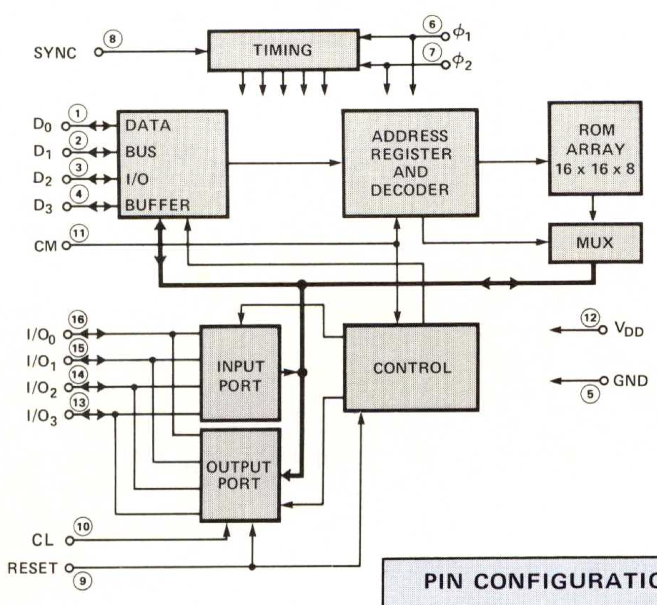
Introduction date: | 1971
Type: | Fully Decoded Static Random Access Memory..
Memory: | 256 x 8-bit
Technology: | P-channel silicon gate MOS technology (10 microns)
Number of transistors:
History: | The 4001 is a 256 x 8-bit ROM designed to be used with other MCS-4/40 devices such as the 4004 CPU.
Reset
9
8
Sync-Out
Clear input
I/O Lines
P₀
10
7
Clk Phase 2
Memory
Control
Input
CM
Clk Phase 1
11
6
-15v V_{DD}
5
V_{SS}
12
i4001
PINS
O₃
13
4
D3
9
8
10
7
O₂
14
3
D2
11
Output
Lines
Data
Bus
I/O
6
12
5
O₁
15
2
D1
13
4
3
O₀
16
1
D0
14
15
2
16
1

Slide 16
SYNC
TIMING
⏀₁
⏀₂
DATA
BUS
I/O
BUFFER
ADDRESS
REGISTER
AND
DECODER
ROM
ARRAY
16 X 16 X 8
D₀
D₁
D₂
D₃
MUX
CONTROL
INPUT PORT
OUTPUT PORT

